Slide 1
API The Beginner Guide
In the context of CDCB’s Data Exchange API

Slide 2
What is API?
It is a set of definitions and protocols for building and integrating application software.
Think of it as a mediator between the clients (3rd parties) and the resources (CDCB’s database)
It help 3rd parties communicate what they want from CDCB’s database so it can understand and fulfil the request.

Slide 3
What is Swagger site (Swagger UI)?
It is an online documentation tool where you can find all the services (endpoints) you can use with the API.
This site automatically generates the document by reading the code.
We use this online document to show 3rd parties what is available for them to access the API.
This site can be replaced by a simple word document that contains a list of endpoints and specifications for each.

Slide 4
What is Postman?
It is an application used for API testing to see what information you can get.
There are many API testing tools in the market. (e.g., Insomnia, Paw)
Even cURL can be used to test the API.
We recommend Postman, but you can use other tools

Slide 5
Example of how they all interact
Think of an API as a waiter.
You have a menu (Swagger Site) to show you the choices that you can order from.
The kitchen is part of the system which will prepare the order (CDCB’s database).
The waiter ( the API) will take the order from you then tell the kitchen (database) what to do and then deliver the food (JSON response) back your table.

Slide 6
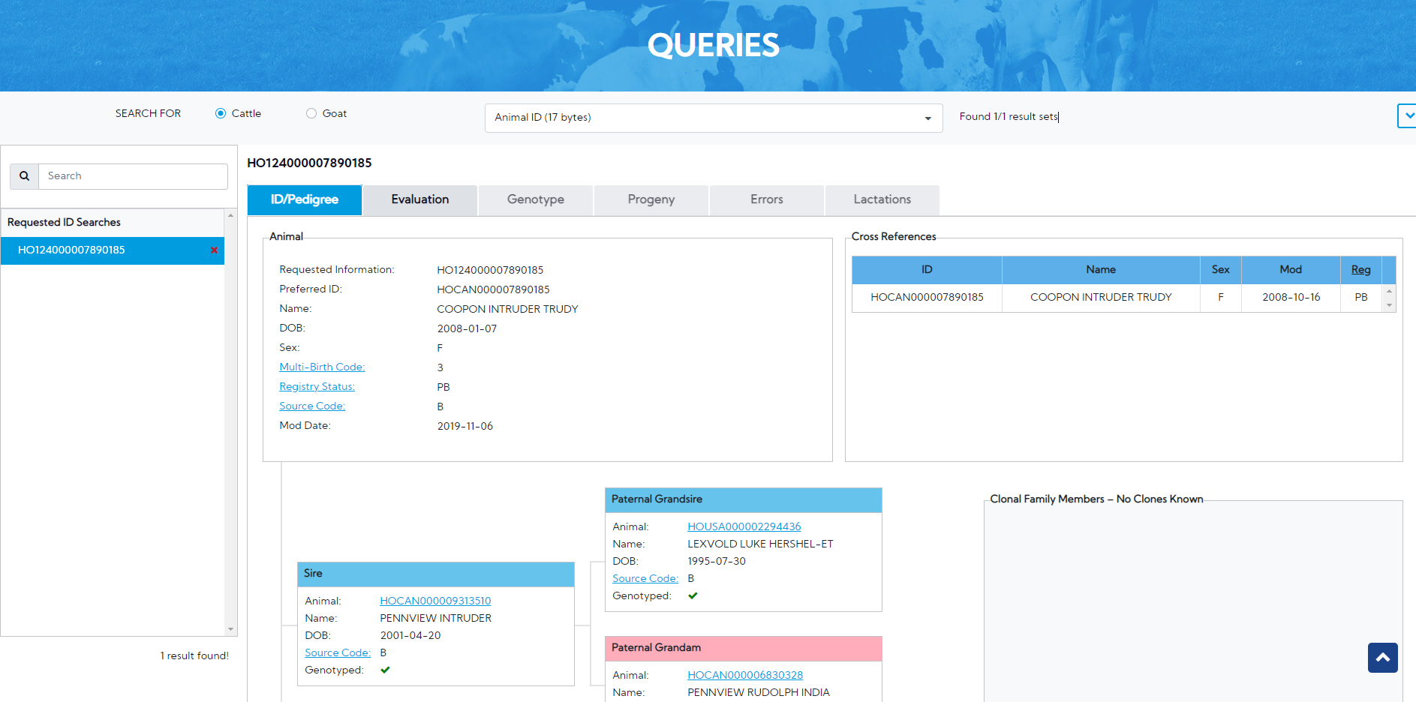
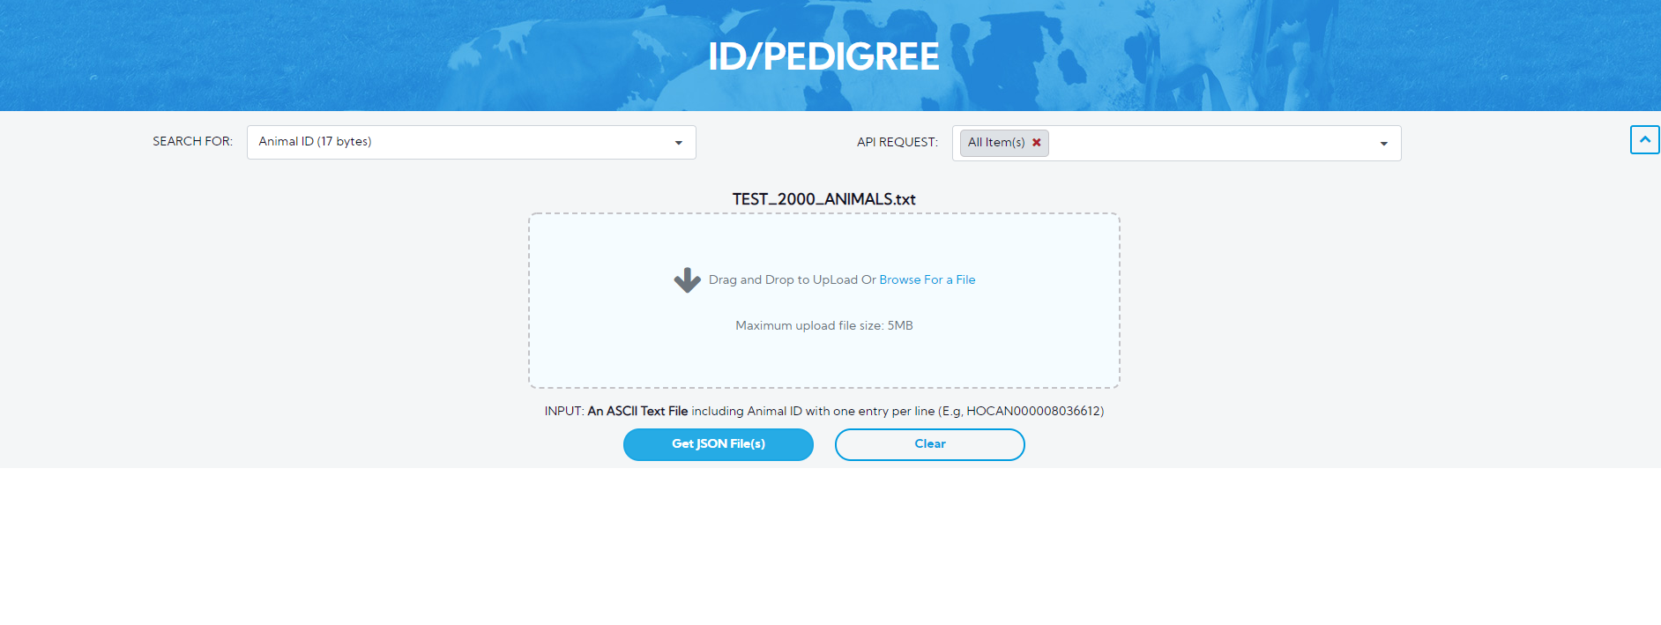
CDCB API Environment
Web Queries
Data-Exchange UI
Data-Exchange 3rd Party
Input(s)
Output(s)
Input(s)
Output(s)
Input(s)
Output(s)
API(s)
API
API
Data Exchange API Documentation
Web Queries API Documentation
Data Exchange 3rd Party API Documentation
Stored Procedure(s)
^{Note:}
(1) Each API handles input(s)/output(s) of its own workflow.
(2) All logics are handled in the Store Procedure of Database.

Slide 7
How to test the CDCB API using Swagger & Postman
Go to Swagger to find the endpoint (query) we want to look at
Copy it
Paste into Postman
Follow Dennis’s video to execute the request
Get results

Slide 8
Confluence User guides for API
How to access Swagger, Get token and use Postman https://uscdcb.atlassian.net/wiki/spaces/WCP/pages/2069626881/6.8.1+Third+Party+Testing+Approach
How to get extra information on parameter value https://uscdcb.atlassian.net/wiki/spaces/WCP/pages/2090827777/6.8.2+Data+Exchange+API+-+Third+party+testing

Slide 9
External References
Definitions of API: https://www.redhat.com/en/topics/api/what-is-a-rest-api
API 101 – short training course: https://www.youtube.com/watch?v=cpRcK4GS068&list=PLcgRuP1JhcBP8Kh0MC53GH_pxqfOhTVLa
Introduction about API: https://www.youtube.com/watch?v=s7wmiS2mSXY&t=7s

