Slide 1
CDCB Quality Control Program
José A. Carrillo, CDCB Chief Data Officer
CDCB Nominators and Laboratories Workshop
September 7-8, 2022

Slide 2
Outline
Introduction
QC Program overview
Database numbers
Summary

Slide 3
CDCB Mission
To drive global dairy cattle improvement by using a collaborative database to deliver state-of-the-art genetic merit and performance assessments for the herd decision making

Slide 4
FEEDBACK
Input Data
Process
Output Data
Storage
FEEDBACK

Slide 5
US Genetic Evaluation Process
Data
Nominators
R&D
AGIL/USDA
CDCB
Implementation
AGIL/USDA
CDCB
DRPCs
PDCA
NAAB
International Cooperators
Services
CDCB
Laboratories
DRP
U.S. Genetic & Genomic Evaluations
5

Slide 6
What is Data Quality?
Accuracy
Completeness
Relevancy
Validity
Timeliness
Consistency

Slide 7
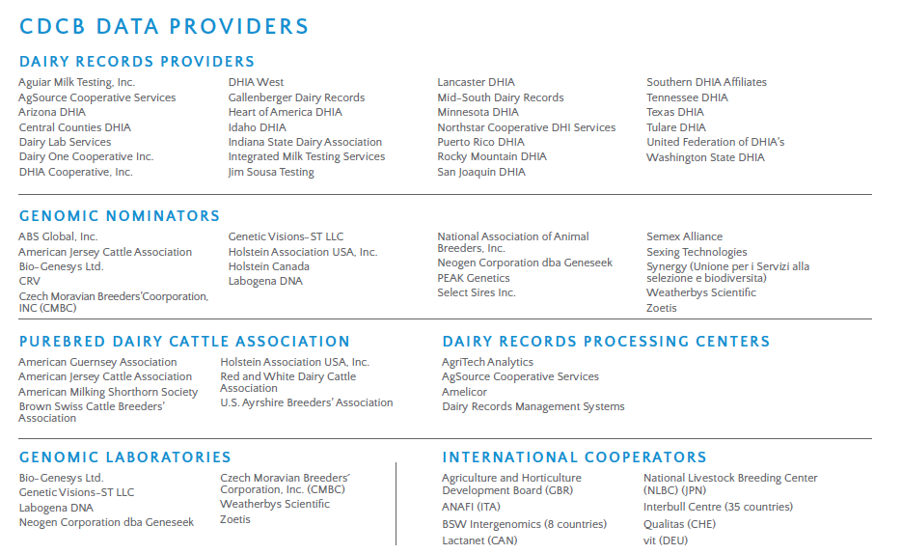

Slide 8
Data Providers

Slide 9
Purpose of the Quality Control program
Ensure the accuracy and uniformity of all records included in the National Cooperator Database
Monitor certified nominators and laboratories performance regularly to ensure quality of data
Detect the needs or issues experienced by CDCB Collaborators
Advise or find solutions for issues/concerns faced by the collaborators
Facilitate the exchange of data (in the most efficient way)
Improve communication between nominators/labs and the CDCB

Slide 10
Genomic data flow
Lab Certification
Dairy Record Provider
(farmer or controller)
Genomic
evaluations
DNA samples
DNA laboratory
DNA samples
Genomic Nominator
Genotypic information
Nominator
Certification
Genotypes
Nominations,
pedigrees
genotype
quality reports
Genomic
evaluations
Council on Dairy Cattle Breeding (CDCB)
10
Notes:
10

Slide 11
CDCB - Certification Process
Application
Proficiency test
Monthly report cards
Annual review
Certification status notification
One time
Repeat Annually

Slide 12
Monthly Report Cards
CDCB Monthly evaluations
Report Card generated and sent to the Nominators/Lab
Feedback received within a week

Slide 13
Annual Review Plan
Metrics Assessment
SOPs Review
Preliminary Review Card
Review meeting
Discuss the Preliminary Review
CDCB Final Recommendations and Status Certification
Propose and define actions

Slide 14
Database Numbers

Slide 15
Genotypes in CDCB Database
6,622,899 (August 31,2022)
15

Slide 16
SNP Chips accepted by the CDCB
SNPs
CDCB accepts 49 types of SNP chips

Slide 17
Genotypes received in 2021 by chip density
17

Slide 18
CDCB usable genotype counts by animal sex
18

Slide 19
International vs Domestic

Slide 20
Foreign Animals (%)

Slide 21
AI breedings using genomic bulls - Holstein

Slide 22
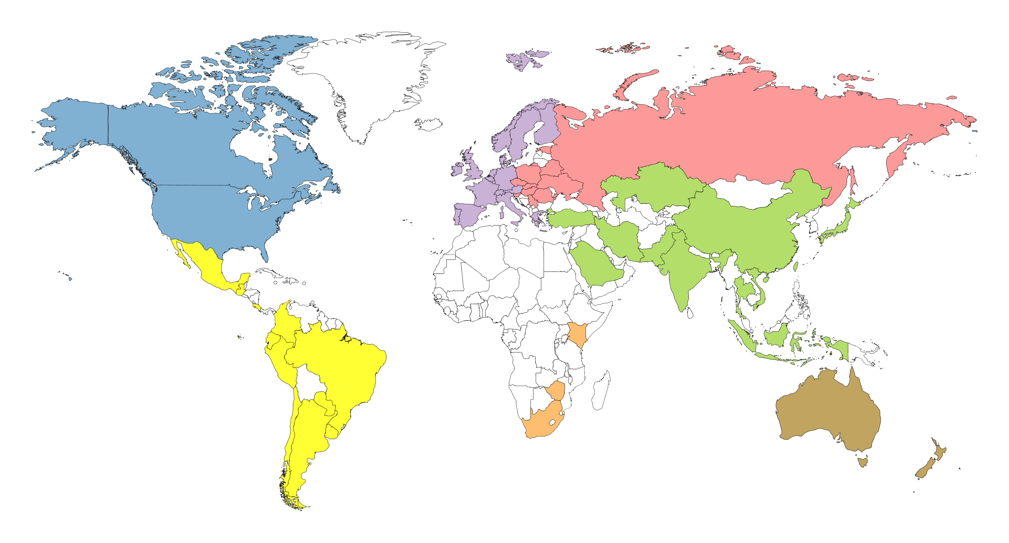
Genotyped animals in CDCB database by region (2022-03-21)
33,787
4,778,090
452,292
372,293
147,628
17,856
63,656

Slide 23
Genotypes by International Countries in CDCB database

Slide 24
Numbers of the Database
More than 6.6 M genotypes
75 Countries, 16 tags manufactures represented (900 series)
Iran is currently suspended due to embargo
For four countries both letter and numeric codes accepted (CAN,124; PAK,586; SAU, 682 and USA,840)
24

Slide 25
Genetic merit of marketed Holstein bulls
Average gain:
$84.51/year
Average gain:
$40.48/year
Average gain:
$13.38/year
25

Slide 26
Summary
The CDCB has developed a customized Quality Control program that has evolved overtime
Previous and current reports demonstrated the positive impact of the program
The QC program assists nominator & laboratories in delivering high quality data and contribute to maintaining the integrity of the CDCB database

Slide 27
Thanks for your attention!
Any questions?

