Slide 1
CDCB QC Audit
Kaori Tokuhisa, CDCB Genomic Data Analyst
José A. Carrillo, CDCB Chief Data Officer
CDCB Nominators and Laboratories Workshop
September 7-8, 2022

Slide 2
Topics
CDCB Nominator QC Metrics Survey results
Nominator audit report (2021)
Laboratory audit report (2021)

Slide 3
CDCB Nominator QC Metrics Survey
Kaori Tokuhisa, CDCB Genomic Data Analyst
José A. Carrillo, CDCB Chief Data Officer
CDCB Nominators and Laboratories Workshop
September 7-8, 2022

Slide 4
CDCB QC Metrics review
CDCB have defined QC Metrics to ensure quality of data and to encourage all nominators and labs to comply with our expectations
We implemented QC Metrics and have been assessing nominator performance since 2017
We implemented QC Metrics and have been assessing laboratory performance since 2018
Great improvement has been made over years
Important to ensure quality of data and customer satisfaction of our service
CDCB conducted a survey to review our QC metrics first time this year
Notes:
Technology improves everyday and some metrics might be out-dated. CDCB wanted to make sure if the metrics are working well for nomiantors.

Slide 5
Purpose of the Survey
To collect feedback on the QC Metrics
To understand the usefulness of the QC Metrics
To identify possible improvements or adjustments to the current QC Metrics

Slide 6
No nomination when loading
Metric classification class: Critical
Threshold: 1%
Explanation: Number of genotypes missing a nomination when loaded. Nominators are required to submit a nomination for each animal whose genotype will be submitted to the CDCB database (including the animal pedigree if it is not yet in the CDCB database), since the information must be present when the genotype arrives from the lab
Why important: Processing and storing genotype cost $$$ and we have to make sure pedigee + fee code are indicated before genotype arrival. If pedigree is missing, CDCB has to reprocess the genotype once the pedigree is available.
Notes:
This is the first metric

Slide 7
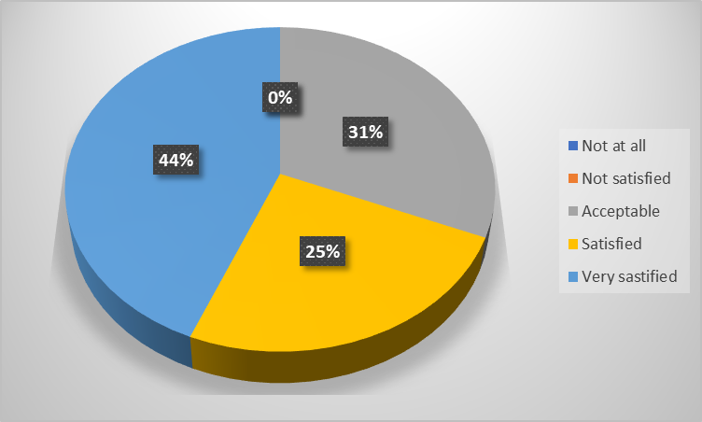
No nomination when loading (1%) - Critical
Number of genotypes missing a nomination when loaded
Comments:
This is an important metric for Nominators, and it helps us track our own success or shortcomings in this category. No improvement recommended.
It can be simplified in a way that both sources of information (genotype and nomination) can be independent.

Slide 8
Unknown animal ID
Metric classification class: Critical
Threshold: 1%
Explanation: Number of genotypes with unknown animal identification(ID) or the genotype conflicts with another genotype assigned to the same animal, so it has been assigned a negative key. This occurs when the animal has not been nominated and the genotype submission is missing the animal ID or the animal ID has not been entered in the CDCB database.
Why important: Orphan genotype without nomination will be put aside (zero-key) until the nomination (pedigree) comes, which requires re-processing. Requires extra burden to our system!

Slide 9
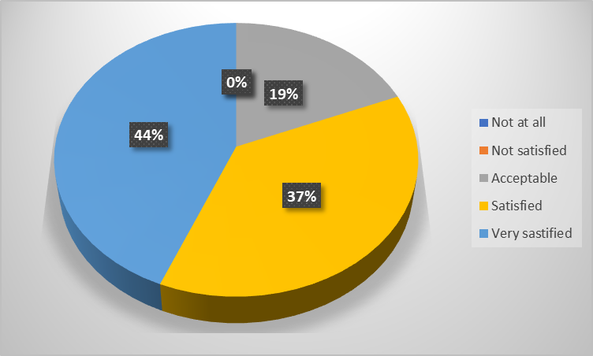
Unknown animal ID (1%) - Critical
Genotypes with unknown animal identification(ID) or the genotype conflicts with another genotype assigned to the same animal, so it has been assigned a negative key
Comments:
Unsure of the real difference between this metric and the "no nomination" metric.

Slide 10
CDCB blanked dams due to conflict
Metric classification class: Major
Threshold: 2%
Explanation: The nominator provided the dam information, but it was rejected and not stored due to a conflict.
    Common reasons for CDCB blanking are:
    Animal birth date does not agree with dams calving date
    A maternal sibling has a birth date within 9 months of the animal submitted.
    Note: These checks are bypassed for embryo transfer genotypes.
Why important: Our editing program has many checks (pedigree, lactation, progeny etc) to validate the dam’s info. It is important to have this check to harmonize info from different source of the data

Slide 11
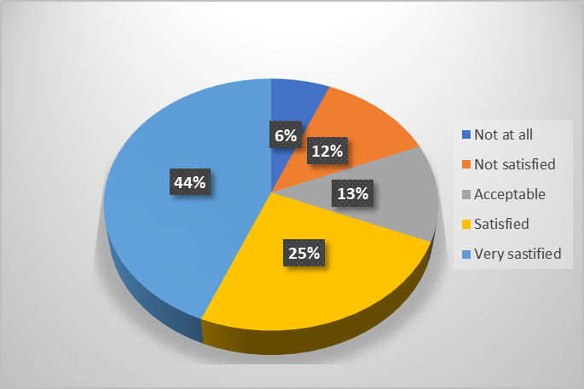
CDCB blanked dams due to conflict (2%) – Major
Dam information provided, but it was rejected and not stored due to a conflict.
Comments:
For non-breed registries, we must rely on the information that is provided to us by the animal's owner.
If genotyping confirms a cow as being the dam of an animal, a calving date/birth date discrepancy should not cause the dam to be blanked.
Is complicated for commercial farms with unattended deliveries at nights to pair in some cases with the correct dam
Notes:
First and third comment basically saying that they do not have control., which we understand. What we ask to nominators is to educate the customers to record data as complete as possible. The second comment implies that we should not blank the dam. At the time of nomination, CDCB does not have genotype data available and a lost of cases, dam has not been genotypes. Therefore, we put this metrics to ensure we have the correct dam information.

Slide 12
Usability code = N
Metric classification class: Major
Threshold: 1%
Explanation: Number of genotypes with conflicts, preventing the genotype from being usable for genomic evaluation purposes. This count includes only those cases that have not been corrected at the time the report was created.
Why important: Collecting accurate and complete information is important for reliable evaluation results. Fixing conflict on timely manner is also important for prompt delivery of CDCB evaluations.

Slide 13
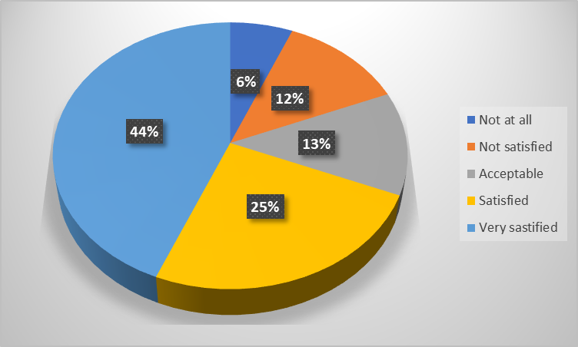
Usability code = N (5%) - Major
Number of genotypes with conflicts, preventing the genotype from being usable for genomic evaluation
Comments:
Many animals are registered or have conflicts that cannot be resolved immediately
The threshold should be set at higher percentage

Slide 14
Fee code = N
Metric classification class: Major
Threshold: 1%
Explanation: Number of genotypes with genomic fee code N
  Most common causes are:
  No fee code was assigned to the individual, therefore it remains with the default value N
  A fee code N was intentionally assigned to the individual
  Sex conflict defaults the fee code to N.
Why important: Assigning fees is critical to get an evaluation and leaving fee code=N will delay the process

Slide 15
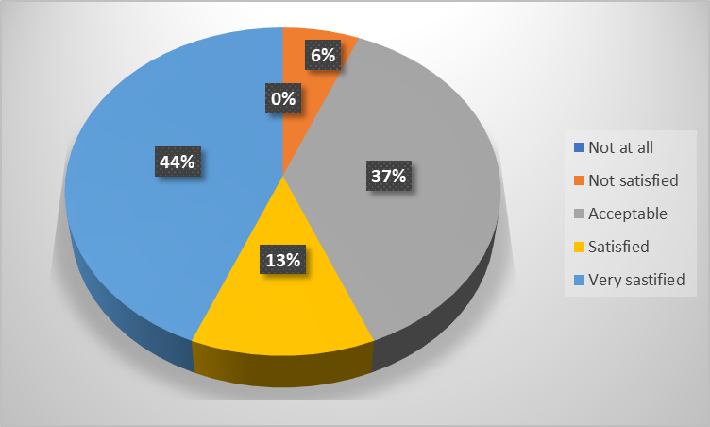
Fee code = N (1%) - Major
Comments:
A Canadian organization should not have to justify each month. We should have the number of fee code N for US animals and others separately.
I don't think of this as a "major" issue.
This metric is influenced by the Usability Code metric, in that animals that have a conflict are not able to be assigned a correct fee code. We would like to see this metric moved to 3%.
Number of genotypes with fee code N

Slide 16
Genotype withdrawn
Metric classification class: Major
Threshold: 1%
Explanation: Number of genotypes that were withdrawn during the reference month. The withdrawal is appropriate only for unusual cases in which the genotype is not expected to ever become usable (e.g. submission of genotype not intended for CDCB, non dairy cattle genotype, etc.)
Why important: Genotype withdrawal failure in identified animals/genotypes correctly. CDCB still need to store the genotype for the misidentified genotypes.

Slide 17
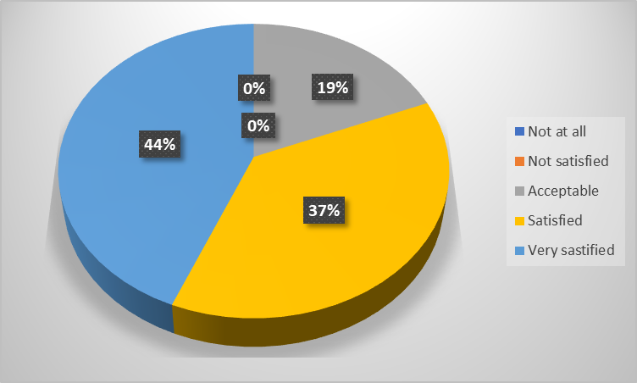
Genotype withdrawn (1%) - Major
Number of genotypes that were withdrawn during the reference month
Comments:
We only withdrawing genotypes upon request from CDCB.
I don't understand the need for this metric.

Slide 18
Genotype reassigned
Metric classification class: Major
Threshold: 1%
Explanation: Genotypes reassigned to a new animal due to an incorrect initial assignment.
Why important: Reassigning genotypes indicates failure in identifying the correct animal. Reassignment requires reprocessing the genotype, which should be minimized.

Slide 19
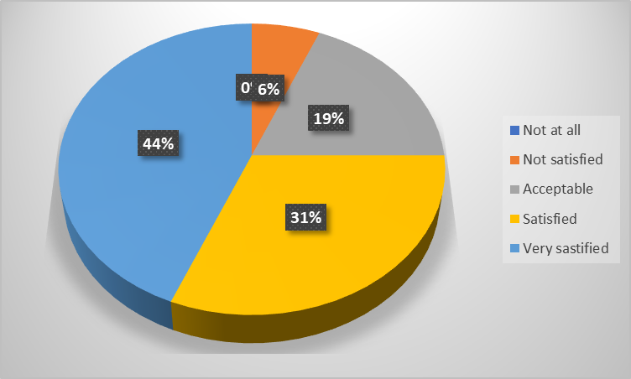
Genotype reassigned (1%) - Major
Genotypes reassigned to a new animal due to an incorrect initial assignment
Comments:
We typically have to reassign genotypes when the dairymen provides us with incorrect IDs. This is something that does occur fairly often and we do not have much control over this.

Slide 20
Changes in pedigree
Metric classification class: Minor
Threshold: 25%
Explanation: Changes in the pedigree of the animal that occurred during the reference month.
Why important: This metrics is less important than others, as CDCB understand that commercial hers depends on CDCB to identifying the parentage or they do not always have the complete data. We still need a threshold to identify any abnormal performance.
It is difficult for CDCB to set a customized threshold for each organization.

Slide 21
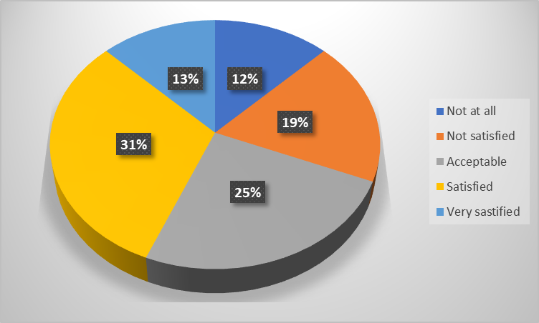
Changes in pedigree (25%) - Minor
Changes in the pedigree of the animal that occurred during the reference month
Comments:
I would find this metric a lot more useful if a "standard" level for each organization was identified and then anything above that was flagged.
I have a few commercial herds who don't really care about data
If a change is needed we changes it when necessary.

Slide 22
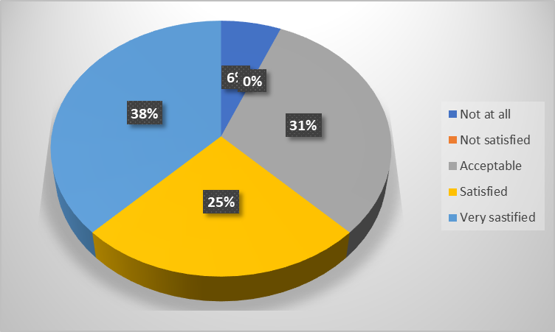
Sire pedigree missing (1%) - Minor
Counts of genotypes without pedigree information of the corresponding sire ID in the CDCB database.
Comments:
Sometimes sires are unknown and genotyping is being used to determine the sire.

Slide 23
Dam pedigree missing
Metric classification class: Minor
Threshold: 10%
Explanation: This metric includes genotypes without pedigree information of the corresponding dam ID in the CDCB database. Unfortunately, this information is not always available on the farm. A high value in this metric may suggest that additional work with customers is needed.
Why important: This metrics is less important than others, as CDCB understand that commercial hers depends on CDCB to identifying the parentage or they do not always have the complete data.

Slide 24
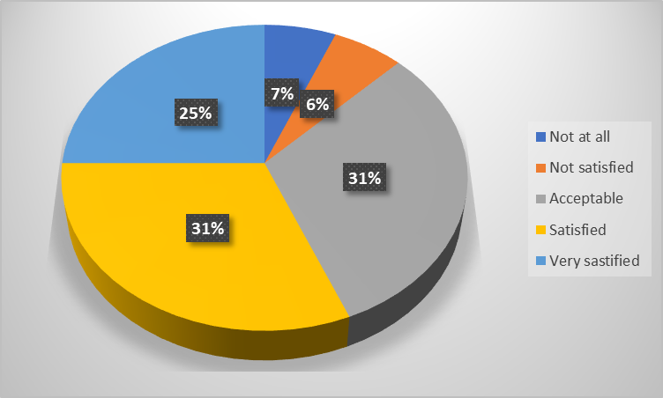
Dam pedigree missing (10%) - Minor
Genotypes reassigned to a new animal due to an incorrect initial assignment
Comments:
The vast majority of international (commercial ) animals do not have dams that have been tested, so we will always miss this metric.
When it comes to herds starting using genomic tools, it is often complicated not to reach that threshold.
It would be good to split this out into US-based versus international-based animals.

Slide 25
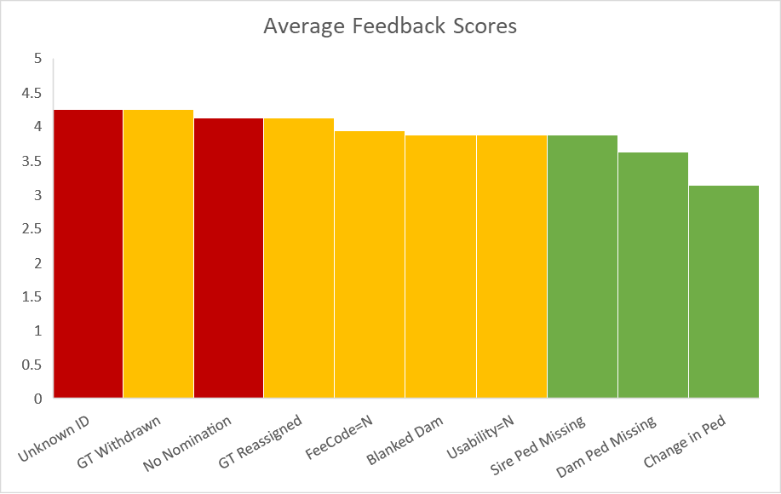

Average Feedback Scores

Slide 26
Summary
It was a great opportunity for CDCB to understand what nominators think about the metrics
Nominators gave an average satisfaction score of approximately 4 or higher for critical and core metrics, meaning those metrics are well accepted by nominators.
Lower satisfaction (avg ~ 3.5) for minor metrics mostly due to the difficulty of setting a threshold for all nominators who have different business model
CDCB will review your comments and metrics
Thank you very much for your effort to meet our expectations and to provide your opinions!

Slide 27
Any Questions?

Slide 28
2021 Nominator Audit Report
Kaori Tokuhisa, CDCB Genomic Data Analyst
José A. Carrillo, CDCB Chief Data Officer
Kendra Randall, CDCB Project Manager
CDCB Nominators and Laboratories Workshop
September 7-8, 2022

Slide 29
Purpose of QC Audit Review
To review certified nominator’s performance to ensure quality of data that nominators provide to CDCB
To advise on or to find solutions for issues/concerns that nominators are facing, in order to help improve nominator’s performance
For CDCB to know the needs or issues that can be addressed or improved to facilitate nominator’s workflow
To provide an opportunity to communicate and exchange information between CDCB and nominators to keep each other informed
Punishing nominators is NOT the purpose of this review

Slide 30
Category of Nominator
(as of August 2022)

Slide 31
Genotypes by Type of Nominator

Slide 32
Number of Loaded Genotypes
(0 key + withdrawn GT excluded)

Slide 33
Main Challenges by Category of Nominator
Breed Associations
  Takes longer to make corrections (confirmation from owners, herd book, analysis, etc.)
Studs (AI companies)
  Uncertain parentage (incomplete pedigree; pooled donors/semen/embryos)
  Getting response back from breeders, breed associations, and DRPCs.
Labs
  Incomplete pedigree/data from commercial herds
  Incomplete data from foreign countries

Slide 34
QC Metrics for Genomic Nominators
No nomination when loading (1%)
Unknown Animal ID (1%)
CDCB blanked dam due to conflict (2%)
Usability code = N (5%)
Fee code = N (1%)
Genotype Withdrawn (1%)
Genotype reassigned (1%)
Change in Pedigree (25%)
Sire pedigree missing (1%)
Dam pedigree missing (10%)
Herd Reason Codes
Nomination Fee Codes Changed
Critical
Major
Minor
Information
https://redmine.uscdcb.com/projects/cdcb-customer-service/wiki/QC_Metrics_for_Genomic_Nominators

Slide 36
Incidence(data point) = $\frac{\# occurrences in the month}{\# Total GT received in the month}$
Notes:
This graph shows average performance of nominators and how their performance changed over years. Basically the each data point represent # occurrence in the month divided by total genotype received in the month.
The numbers above shows P values, which indicate how significant the difference is between the two years. As you can see the performance is significantly improved compared to 2017 and 2018, and stays great in 2019,2020, and 2021.

Slide 38
Incidence(data point) = $\frac{\# occurrences in the month}{\# Total GT received in the month}$

Slide 40
Incidence(data point) = $\frac{\# occurrences in the month}{\# Total GT received in the month}$

Slide 42
Incidence(data point) = $\frac{\# occurrences in the month}{\# Total GT received in the month}$

Slide 44
Incidence(data point) = $\frac{\# occurrences in the month}{\# Total GT receivedin the month}$

Slide 46
Incidence(data point) = $\frac{\# occurrencesin the month}{\# Total GT receivedin the month}$

Slide 48
Incidence(data point) = $\frac{\# occurrences in the month}{\# Total GT received in the month}$

Slide 50
Incidence(data point) = $\frac{\# occurrences in the month}{\# Total GT received in the month}$

Slide 52
Incidence(data point) = $\frac{\# occurrences in the month}{\# Total GT received in the month}$

Slide 54
Incidence(data point) = $\frac{\# occurrencesin the month}{\# Total GT received in the month}$

Slide 55
Summary of metrics
QC Metrics | Observation
No Nomination | Great improvement after 2017. Stayed lower than the threshold in 2018-2021
Unknown ID | One outlier in 2021 but stays constant throughout 5 years. Slightly lower in 2018
CDCB Blanked Dam | Significant improvement observed every year. Great work!
Usability=N | Significant improvement observed every year. Constantly great in 2020 and 2021(under threshold)
Free Code=N | Remained under the threshold. Great work in the past 5 years.
GT Withdrawn | Significant improvement after 2017 (under threshold)
GT Reassigned | Significant improvement after 2017 (under threshold)
Change in Pedigree | Significantly higher 2022, compared to 2017 (over threshold)
Sire Pedigree Missing | Significantly higher compared to 2017 and 2018 (under threshold)
Dam Pedigree Missing | Significant increase in 2022, compared to past 4 years (over threshold)

Slide 56
Improved, under threshold or same
No nomination Coordination of timing with the lab is the key to improve the metric
Unknown ID There is low incidence and no concern
Blanked dam Great improvements every year.
Usability=N Some nominators have hard time fixing conflict before deadline
Fee code=N A bit of struggle when fee is changed to N due to sex conflict but nominators
are adjusting the procedure and handling it well
GT withdrawn Withdrawals have been done at minimal level when it really must be done
GT Re-assigned Reassignments have been done at minimal level when it really must be done
Sire ped missing SD is smaller than 2020’s. Increasing trend is due to increased incomplete data
coming from commercial + international herds or pooled
donors/semen/embryos
Deteriorated
Change in Ped Probably due to increased incomplete data coming from commercial +
international herds or pooled donors/semen/embryos
Dam Ped missing Probably due to increased incomplete data coming from commercial +
international herds or pooled donors/semen/embryos

Slide 57
Summary of Nominator QC Audit Review
Overall, improvement or consistency was observed in most metrics– The CDCB really appreciates your effort!!
Pretty much similar to the previous year (2020)
It was a great opportunity for the CDCB and the nominators to exchange comments on each operation
The QC audit final report should have been sent to each nominator
The CDCB is always open to discuss possible improvements regarding our system and the operation of the nominators

Slide 58
2021 Laboratories Audit Report
Kaori Tokuhisa, CDCB Genomic Data Analyst
José A. Carrillo, CDCB Chief Data Officer
Kendra Randall, CDCB Project Manager
CDCB Nominators and Laboratories Workshop
September 7-8, 2022

Slide 59

QC Metrics for Genomic Laboratories
Submissions with fewer than 10 animal genotypes
Submissions failing on SNP call rate (across animal)
Submissions failing on SNP parent-progeny conflicts
Submissions flagged on Hardy-Weinberg equilibrium (HWE)
Percentage of animal genotypes with No Nomination
Submissions failing on excessive conflicts per chip
Submissions having low call rate genotypes
Critical
Information
https://redmine.uscdcb.com/projects/cdcb-customer-service/wiki/QC_Metrics_for_Genotyping_Laboratories
Notes:
Again, I would like to go over the lab QC metrics that we used in the latest assessment. Unlike nominator metrics, we only have 4 critical metrics.
The four metrics are: “Submissions with fewer than 10 animal genotypes”, “Submissions failing on SNP call rate”, “Submissions failing on SNP parent-progeny conflicts”, and “Submissions flagged on Hardy-Weinberg equilibrium (HWE)”. We still report “Percentage of animal genotypes with No Nomination”, “Submissions failing on excessive conflicts per chip”, and “Submissions having low call rate genotypes” but we do not assess those metrics. We keep them because we think they might be useful for you to detect or identify issues.

Slide 61
Incidence(data point) = $\frac{\# Total failed batches of the lab in the year }{\# Total batches submitted by the lab in the year}$

Slide 63
Incidence(data point) = $\frac{\# Total failed batches of the lab in the year }{\# Total batches submitted by the lab in the year}$

Slide 65
Incidence(data point) = $\frac{\# Total failed batches of the lab in the year }{\# Total batches submitted by the lab in the year}$

Slide 67
Incidence(data point) = $\frac{\# Total failed batches of the lab in the year }{\# Total batches submitted by the lab in the year}$

Slide 68
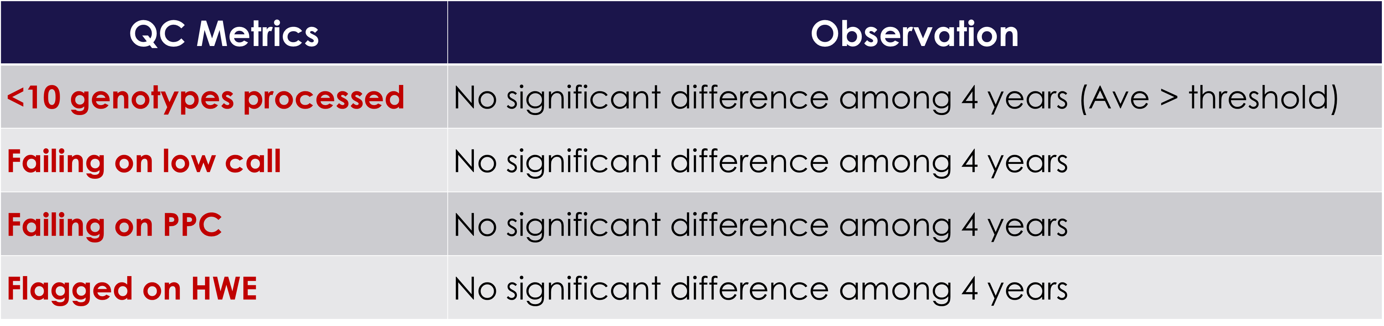
Summary of metrics

Slide 69
Improved, under threshold or same
<10 genotypes processed
Because genotypes could not be combined in a single file, just before the deadline
The scale of operation cannot guarantee batches >10 genotypes
overhead time (and dumpfile removal) require 20mins currently -> 6 mins
Failing on PPC
Issues with a specific chip
Clustering issue
Flagged on HWE
Foreign population that is not close to reference population
The sample size in the batch is just over 50, and the variation in the small batch was caught as failure
Failing on low call
Possible deterioration of SNP performance (Periodic checks on usability of SNPs should be done)
Internal threshold/check differs from CDCB’s

Slide 70
Summary of Lab QC Audit Review
All metrics are under control. Enhancement in our system should make “<10GT processed” less critical.
Final QC audit report should have been sent to each laboratory
The CDCB is always open to discuss possible improvements regarding its system and the operation of the laboratories

Slide 71
Thank you!
Any questions?

