Slide 1
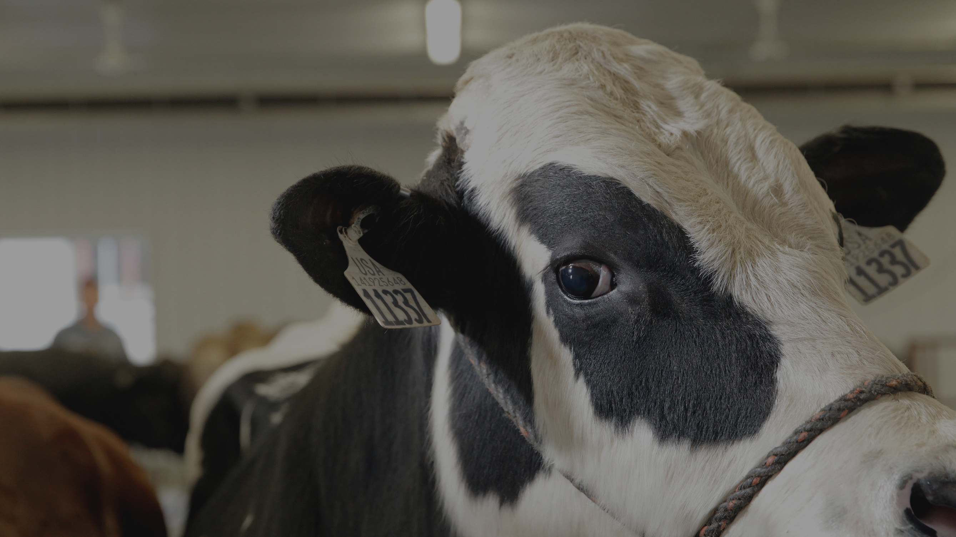
CDCB NOMINATOR WORKSHOP
8TH SEPTEMBER
National Association of Animal Breeders
The role of NAAB &
The Dairy Cross Reference Database

Slide 2
CDCB NOMINATOR WORKSHOP
8 SEPTEMBER
National Association of Animal Breeders
The industry has an issue
Bull owners worldwide are not informed of the regulations when bulls become AI bulls
This leads to:
1. Bull owners avoiding payment of AI service fees, putting more work at NAAB to monitor and trace
2. Daughter performance not being linked to AI bulls when NAAB codes are not reported
3. Unhappy bull owners world-wide due to unexpected bills and blockage of evaluations
0902

Slide 3
CDCB NOMINATOR WORKSHOP
8 SEPTEMBER
National Association of Animal Breeders
We need to collaborate
All parties involved need to educate the customer at nomination that when bulls are selected for AI, there are processes and rules to follow to ensure continuous access to US genomic evaluations and prevent unexpected bills and penalties.
0902

Slide 4
CDCB NOMINATOR WORKSHOP
8 SEPTEMBER
National Association of Animal Breeders
Who is NAAB?
12

Slide 5
CDCB NOMINATOR WORKSHOP
8 SEPTEMBER
National Association of Animal Breeders
Trade Association
Regulation and Unification
Non-profit trade association serving the US AI industry.
Works in those areas where a unified voice is more effective than individual positions being represented
`Self Regulation
Development coincided with the expansion in the use of AI as a means of cattle improvement. The industry decided it was best to self regulate while monitored by the US government
Unification
NAAB provides a platform where interchange of ideas may take place. NAAB is obligated to represent the collective interests of the entire industry rather than the specific interests of an individual member.

Slide 6
CDCB NOMINATOR WORKSHOP
8 SEPTEMBER
National Association of Animal Breeders
1
2
Set minimum standards for semen preparation.
Monitor collection facilities
Address trade barriers and other industry-wide international challenges
NAAB & CSS roles
3
4
Collaborate with government on export health certificates
Maintain Dairy and Beef Cross Reference Database for genetic evaluations
5
6
Provide educational materials
on the US Genetic Evaluation system and AI Industry
Report accurate industry statistics on semen sales

Slide 7
CDCB NOMINATOR WORKSHOP
8 SEPTEMBER
National Association of Animal Breeders
1
2
Maintain Dairy and Beef Cross Reference Database for genetic evaluations
Communicate to CDCB which bulls are AI and which need a sire evaluation
NAAB roles in the sire evaluations
3
4
Handle accounting for AI bulls for CDCB – AI service fees
Monitor the use of CDCB genomic evaluations on AI bulls worldwide

Slide 8
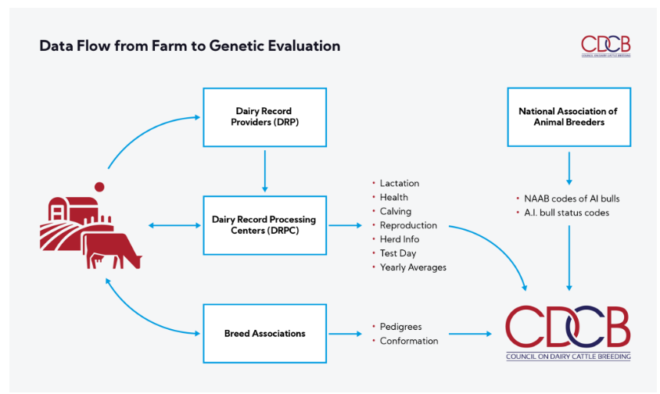
= NAAB codes are part of the data exchange

Slide 9
CDCB NOMINATOR WORKSHOP
8 SEPTEMBER
National Association of Animal Breeders
How we are
connected
12

Slide 10
CDCB NOMINATOR WORKSHOP
8 SEPTEMBER
National Association of Animal Breeders
Process Flow
Nomination
Marketing of AI bull
Semen used on farm
NAAB
informs
CDCB
Enrollment with NAAB
Initial Evaluation
Bull selection
AI bull
allocation
Invoice of
fees
Tri-annual
Evaluation

Slide 11
CDCB NOMINATOR WORKSHOP
8 SEPTEMBER
National Association of Animal Breeders
1
2
Bulls that are marketed on US genomic proofs are subject to an AI service fee
Bulls are not allowed to be marketed on initial evaluations
The rules of the game
3
4
All bulls with an NAAB code must be reported to NAAB and registered in the NAAB DCR
NAAB collects the AI service fee on behalf of CDCB. CDCB determines the fee amount and regulations
5
6
Bulls with an active status and semen release date are invoiced the AI service fee following first evaluation
NAAB and CDCB can block genomic evaluations on bulls when rules are not followed, or fees are not paid

Slide 12
CDCB NOMINATOR WORKSHOP
8 SEPTEMBER
National Association of Animal Breeders
The NAAB
Dairy Cross Reference
12

Slide 13
CDCB NOMINATOR WORKSHOP
8 SEPTEMBER
National Association of Animal Breeders
One of the responsibilities of NAAB as regulator is traceability
1
Link farm to bull
2
Protect trade
3
Bull identifier
By the cross-reference databases, on-farm performance data gets linked to the right sire for genetic evaluations
Exported semen can be traced back to where, when and by whom it was collected. Sire information can be resourced for validation
The NAAB uniform code is a key, well-known, identifier of AI bulls with US proofs and is used on industry material in the US and world-wide

Slide 14
CDCB NOMINATOR WORKSHOP
8 SEPTEMBER
The NAAB Uniform Code
1
Marketing code
2
Breed Code
3
Bull ID number
3-digit code. Identifies semen marketer and type of semen, can be the same as the stud code
2-letter Breed Code
5-digit Bull Specific Number
029
HO
01234

Slide 15
CDCB NOMINATOR WORKSHOP
8 SEPTEMBER
National Association of Animal Breeders
The NAAB Uniform Code
Is essential for traceability of semen and for linking performance data to genetic evaluations
Is called many things - cane codes, sire codes - but is owned by NAAB and should be referred to as the NAAB Uniform Code
Is mandatory to report to NAAB so traceability can be ensured. Unknown NAAB codes on semen means semen cannot be deemed secure

Slide 16
CDCB NOMINATOR WORKSHOP
8 SEPTEMBER
National Association of Animal Breeders
What else is in the
Cross-Reference Database
1. Bull information:
2. Bull controller
3. Bull status code
Name, birthdate, breed, country of origin, genetic evaluation data
Who owns or markets the bull and with which NAAB codes
What is the semen status of the bulls:
Semen currently released?
Semen marketed? Genomic or proven bull?
28

Slide 17
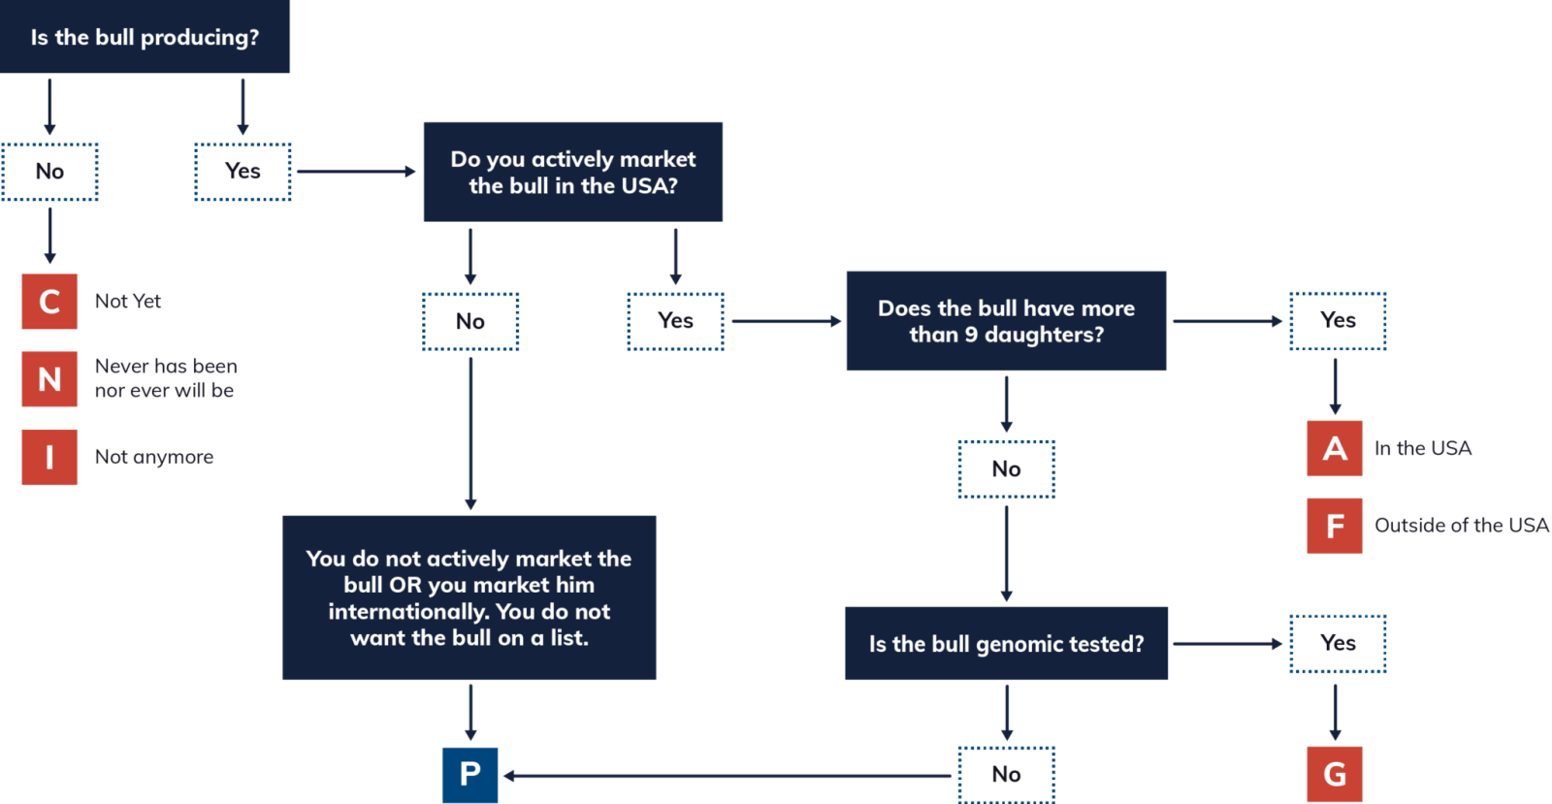
CDCB NOMINATOR WORKSHOP
8 SEPTEMBER

Slide 18
CDCB NOMINATOR WORKSHOP
8 SEPTEMBER
National Association of Animal Breeders
The Sire Evaluation Process
1
Inventory Update
2
Update AIS fee paid field
3
Status code updates
6 weeks before sire summary. Generate file that includes all new bulls, NAAB codes and other updates since the previous sire summary. For December that date will be October 21, 2022. Bulls must be on this list to be eligible for high ranking A.I. bull lists.
Bulls that are used in an A.I. program but have not paid the AIS fee are marked with an X to prevent the calculation of a genomic evaluation. Domestic or International. Only receive traditional evaluation. Bulls coded P or G, receive genomic evaluations and controller agrees to pay AIS fees.
Between Inventory Update and Sire Summary week, the database is partially open to allow status updates. No new bulls or NAAB codes can be added during this time.

Slide 19
CDCB NOMINATOR WORKSHOP
8 SEPTEMBER
National Association of Animal Breeders
The Sire Summary Process
Prepare Final file of A.I. bulls
4
Reports to controllers
5
Last Minute Update (LMU)
6
Tuesday of sire summary, NAAB generates reports for all controllers listing the proof information of bulls they control. Domestic and International.
Wednesday of sire summary, bull owners make LMU updates on status of bulls. NAAB validates that the bulls qualify for the code assigned and changes if necessary, ie G bull with 10 daughters in the US is changed to an A status.
Send file to CDCB to compare with their database. CDCB uses the controller and status information to create the list of bulls to invoice for AIS fees. NAAB generates the invoices and collects the fees.
NAAB also generates the AISS files for public use.

Slide 20
CDCB NOMINATOR WORKSHOP
8 SEPTEMBER
National Association of Animal Breeders
Post Sire Summary Process
C status bulls with breedings or daughters
15-month International Alert
7
8
P Status bulls over 7 years
9
Check C status bulls for SCR and SCE data. Communicate with bull owner if there is an issue. C status bulls older than 3 years of age with no breedings or daughters are changed to N status.
P status bulls 7 years or older are changed to Inactive (I). Assumed they are no longer marketed. Controller would need to contact NAAB to change back to any other appropriate status.
International controllers that have bulls enrolled with C status and will be over 15 months of age at next sire summary are notified. No genomic evaluation will be calculated if status remains a C. Status must be changed to G or P indicating the controller agrees to pay the CDCB AIS fee.

Slide 21
CDCB NOMINATOR WORKSHOP
8 SEPTEMBER
National Association of Animal Breeders
What we need
12

Slide 22
CDCB NOMINATOR WORKSHOP
8 SEPTEMBER
National Association of Animal Breeders
What we are currently doing
10
Monitor International and Domestic A.I. bulls
Routinely monitor domestic and international bulls that are marketed using CDCB genomic evaluation data and are not in the database. Contact bull owners to explain the program. Examples: 1. bulls exported from the USA to Mexico A.I. center but ownership not transferred. Still looks like a US owned bull. 2. Kenya A.I. center marketing semen using CDCB data from 2016 & 2017, pre base change. 3. European bulls evaluated by CDCB and exported to Russia.
Also work with custom collection facilities to clarify/educate how the Cross Reference database/system works and how the industry partners are intertwined.
Some international bull owners market semen using the initial genomic evaluation when the bull was nominated to avoid paying the AIS fees. Nominators have a responsibility to explain the fee schedule to owners nominating males.

Slide 23
CDCB NOMINATOR WORKSHOP
8 SEPTEMBER
National Association of Animal Breeders
Where we need your help
Educate and Inform bull owners at nomination or sale of test for males
Explain to customers that additional fees exist down the line if males are selected for AI
Inform customers that when bulls are selected for AI, any bull with an NAAB code must be reported to NAAB for registration in the Dairy Cross Reference Database. Not complying with the regulations may lead to blocking of future genomic evaluations.
Inform customers, especially international, that bulls are not allowed to be marketed on initial evaluations. If bulls are marketed using US genomic values, then AI service fees must be paid.

Slide 24
CDCB NOMINATOR WORKSHOP
8 SEPTEMBER
National Association of Animal Breeders
Suggested wording to add to results/agreements
‘You are requesting/receiving a CDCB genomic evaluation for a dairy bull. If this bull is utilized for artificial insemination (A.I.) and semen is marketed using the CDCB genomic evaluation data, additional responsibilities and fees apply.
The bull must be enrolled in the NAAB Dairy Cross Reference database and the CDCB A.I. service fee must be paid when semen is commercialized utilizing CDCB genomic values. As your nominator, it is our responsibility to inform bull owners of these additional fees. Approved laboratories are equally obligated to assist with informing bull owners of the fee schedule and cooperate to collect the fees. ‘
0902

Slide 25
CDCB NOMINATOR WORKSHOP
8 SEPTEMBER
National Association of Animal Breeders
Website
www.naab-css.org
Thank you!
Phone Number
+1 (608) 827-0277
Contact us if there are any questions.
Email Address
Naab-css@naab-css.org
29

